Slide 1
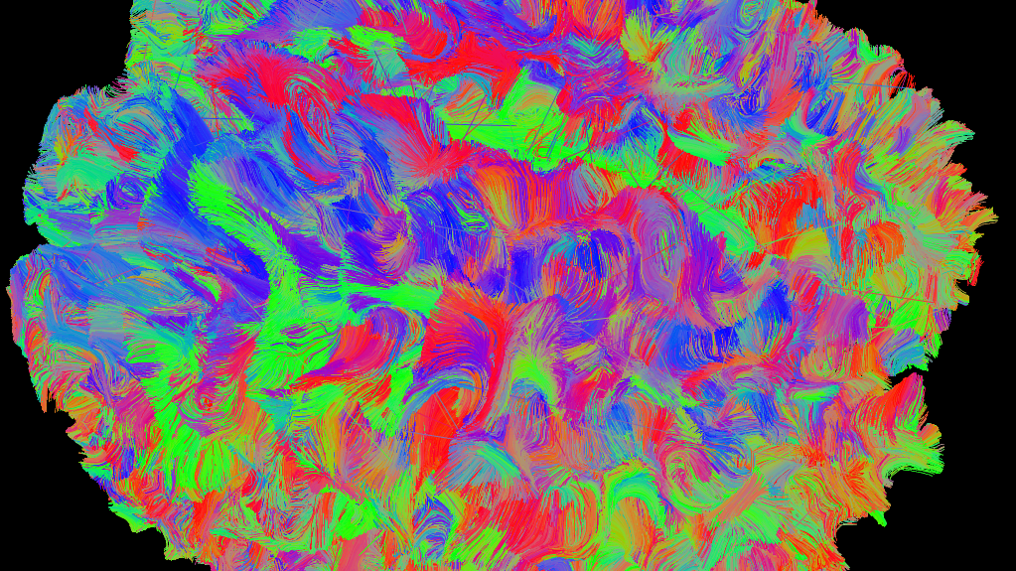



Technical processing of diffusion MRI data for connectomics in pre- and post-surgical patients with drug-resistance epilepsy
Alma Rosa Cuevas Romero
Ai Wern Chung
September 2021 to January 2022
Notes:
Can we (with neuroimaging) identify markers from MRI imaging preoperatively that can predict postsurgical outcomes

Slide 2
Outline
Introduction
Methods
Results
Conclusion
Notes:
Retrieval and Organization
Brain segmentation
Quality Control
T1W
DWI
Gradient Direction correction
Five tissue type generation
Tractography
Spared-network Tractography
Connectomes
Brain Connectivity Measures

Slide 3

The surgical removal of the epileptic brain in early life is available for the
of patients whose epilepsy is resistant to multiple antiepileptic drugs (Löscher & Sills, 2007).
30%
Notes:
In half of the patients, clear lesions are not visible in the structural magnetic resonance imaging (MRI), therefore diffusion MRI-derived features, such as anisotropy and mean diffusivity, are being incorporated to locate epileptic pathology before undergoing the neurosurgical treatment (Larivière et. al, 2020).
Sometimes, these operations do not solve the problem – it is posible that a patient will continue to have seizures.
As surgery can be highly invasive, wouldn’t it be helpful for surgeons to be to predict the potential outcome of their intervention?
The goal of this project is to identify markers from MRI neuroimaging before an operation that can predict postsurgical outcomes

Slide 4
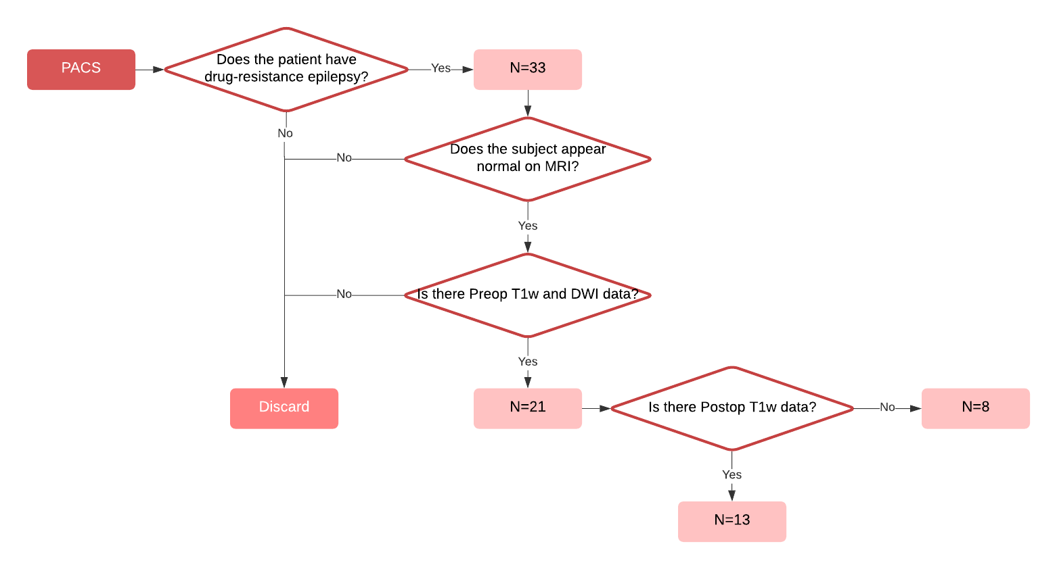
Inclusion and exclusion criteria
Notes:
We assessed the data from 21 patients aged 4-19 years old (12.53±4.23 years) scanned at the Boston Children’s Hospital between 2010 and 2021.
Does the subject appear normal on MRI?
Is there Preop T1w and DWI data?
Is there Postop T1w data?
Font bigger
Identifying our epilepsy cohort

Slide 5
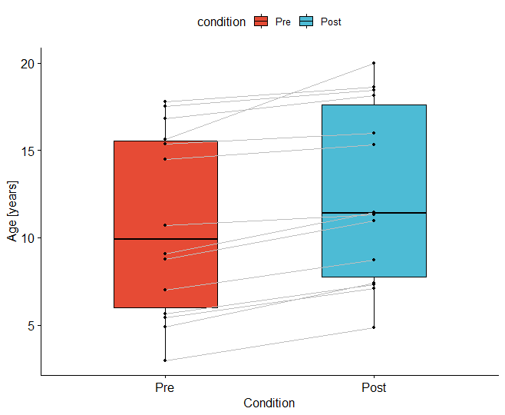
Demographics
*Normal distribution

Slide 6
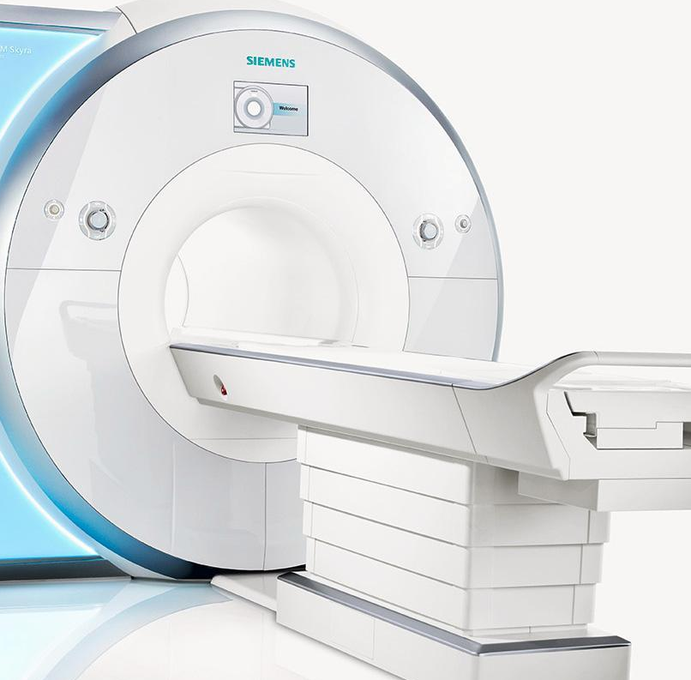
3T Siemens system
 | T1w
Voxel size | 0.86x0.86x0.86mm- 1.04x1.04x1.04mm
Time to Echo (TE) | 1.66-3.39ms
Repetition Time (TR) | 1660-2530ms
Clinical MRI Acquisitions
 | DWI
Gradient directions | 35 – 70 volumes
b values | 700 – 1000 s/mm²
b=0s/mm² | 1 – 10 volumes
Voxel size | 1.85x1.85x1.85mm - 2x2x2mm
Time to Echo (TE) | 4.3-12.827ms
Repetition Time (TR) | 90ms
TIM Trio, Skyra, Verio and Magnetom Vida
Notes:
the multi-echo acquisition MRI was performed on a 3T Siemens system (TIM Trio, Skyra, Verio and Magnetom Vida). “restricted us the protocol that we followed”
This is for all 21 pre and 14 post

Slide 7
3T Siemens system
 | T1w
Voxel size | 0.86x0.86x0.86mm- 1.04x1.04x1.04mm
Time to Echo (TE) | 1.66-2.52ms
Repetition Time (TR) | 2000-2530ms
Clinical MRI Acquisitions
 | DWI
Gradient directions | 35 – 70 volumes
b values | 700 – 1000 s/mm²
b=0s/mm² | 1 – 10 volumes
Voxel size | 2x2x2mm
Time to Echo (TE) | 4.3-12.14ms
Repetition Time (TR) | 90ms
TIM Trio, Skyra, Verio and Magnetom Vida
Notes:
the multi-echo acquisition MRI was performed on a 3T Siemens system (TIM Trio, Skyra, Verio and Magnetom Vida). “restricted us the protocol that we followed”
*check the b values and b0s and gradients
Only the 13 subjects

Slide 8
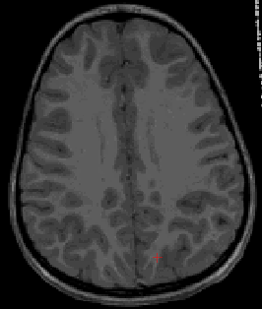
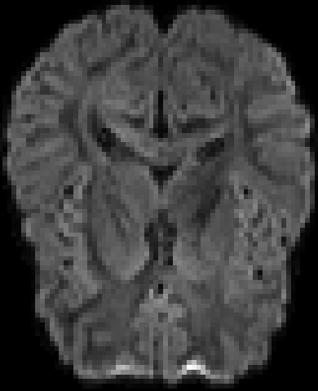

Surgery Date
T1w
T1w
DWI
1
2
3
Preop MRI scan
T1w & DWI
Postop MRI scan
T1w
Notes:
The preoperative and postoperative structural (T1 weighted) and diffusion-weighted imaging (DWI) sequences were recovered per subject from the database (proximity to surgery depended on availability),
Experimental setup

Slide 9
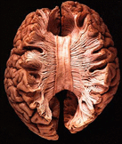
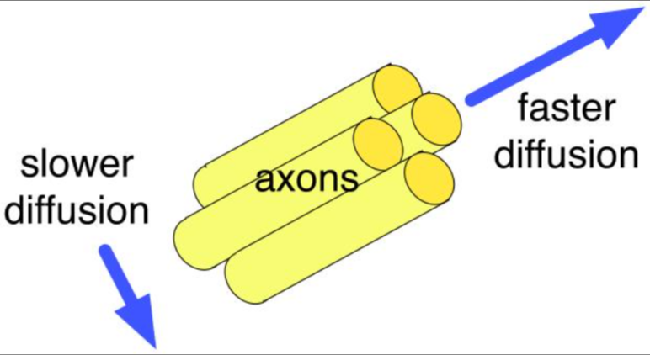
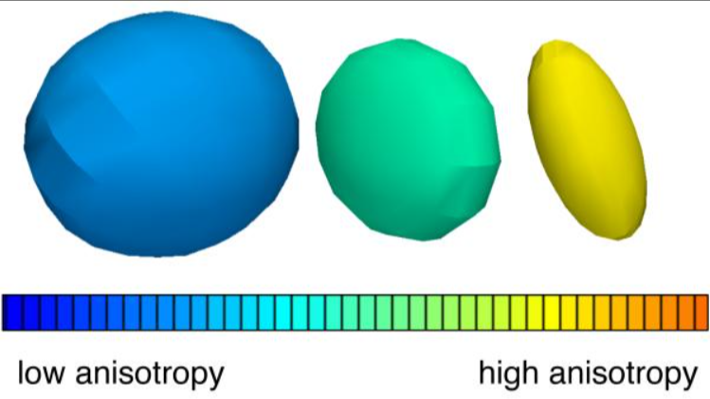
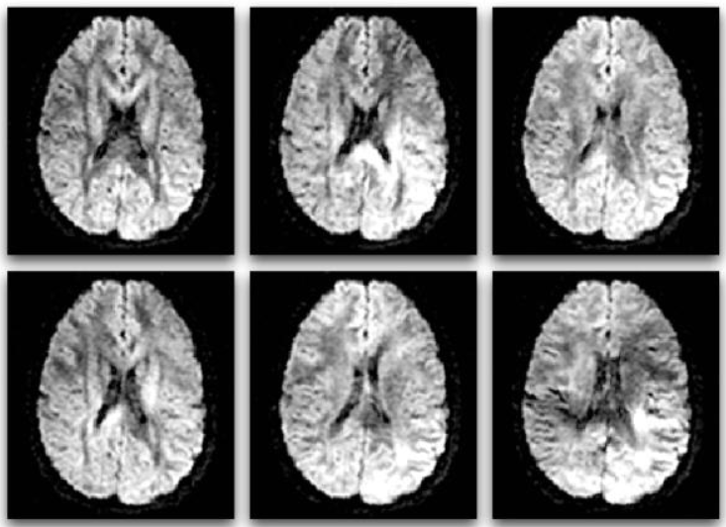
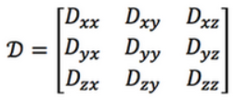
Dissected brain showing white matter tracts (Questions and Answers ​in MRI, n.d.)
Anisotropic diffusion
Examples of diffusion tensors
Diffusion MRI
Array known as the Diffusion Tensor (Questions and Answers ​in MRI, n.d.)
Six DWI volumes with different gradient directions
(O'Donnell & Westin, 2011)
Notes:
In diffusion MRI, magnetic field gradients are employed to sensitize the image to diffusion in a particular direction. The direction is different for each image, resulting in a different pattern of signal loss (dark areas) due to anisotropic diffusion.
Faster – dark
Slower - white

Slide 10
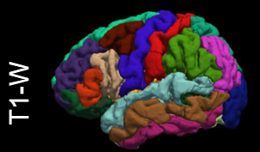
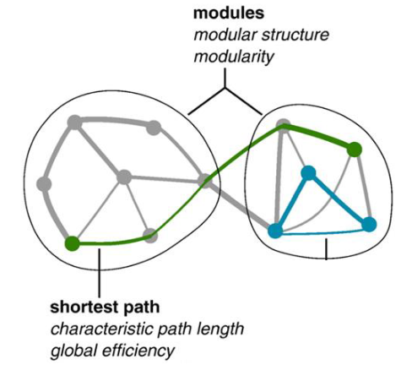
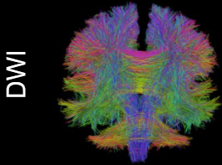
The brain segmentation atlas (Desikan-Killliany) determines the nodes
Network
(Rubinov and Sporns, 2010)
Tensor-based tractography gives the edges
Notes:
Diffusion MRI allows us to measure the Brownian motion of wáter molecules in the brain in many directions.
We can fit diffusion models, such as the difusión tensor model, to the data to descrbe the White matter´pathways.
These pathways can be used to créate a connectome, which is a network of connected brain regions
.

Slide 11
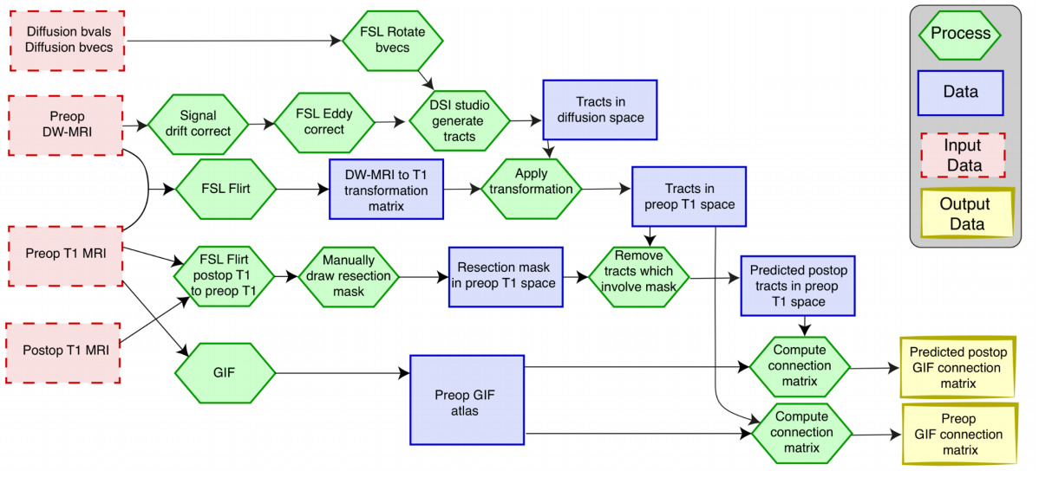
Inspired protocol
(Sinha et. al, 2020)

Slide 12
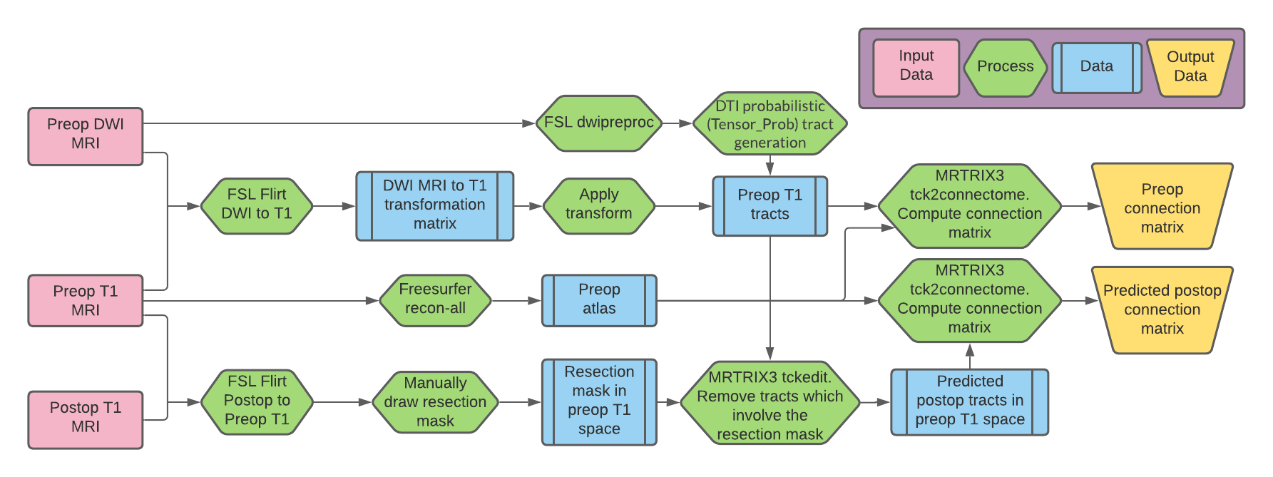
Analysis pipeline
Inspired by (Sinha et. al, 2020)
Notes:
Add contextual difusión análisis protocol

Slide 13

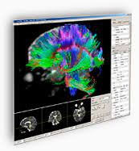
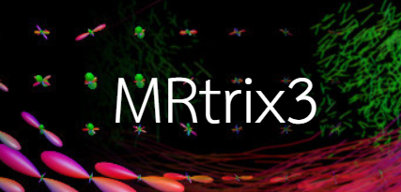

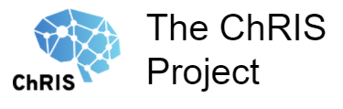

FSL and MRTRIX3 are comprehensive libraries of analysis tools, ChRIS (ChRIS Research Integration System) is an image processing platform, FreeSurfer is package for the analysis and visualization of neuroimaging data and TractVis visualize and analyze fiber track data.
Main software used

Slide 14
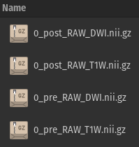
Data organization
T1w
DWI
Anonymise data
Rename files with subject ID
Convert DICOM to NIFTI format
Select subjects:
Create a local copy
Package and compile

Slide 15
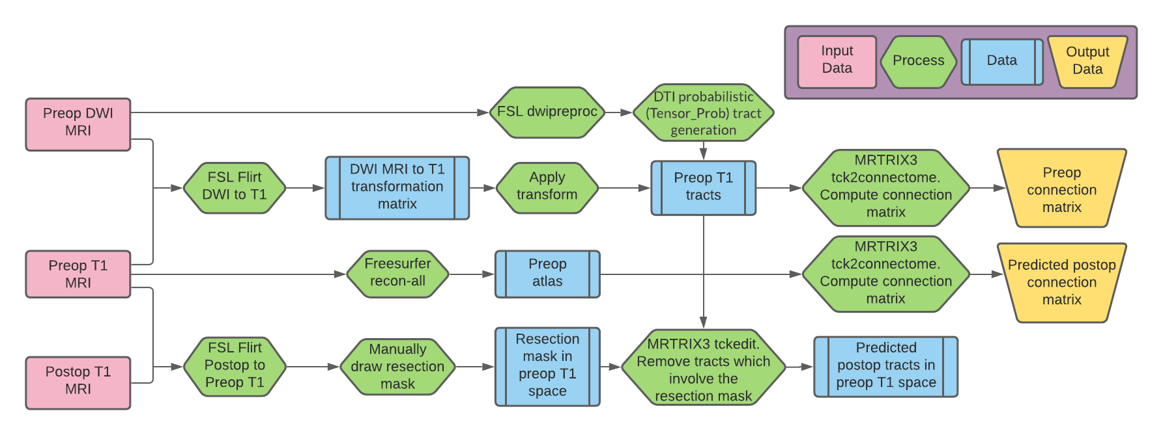
Where are we going?

Slide 16
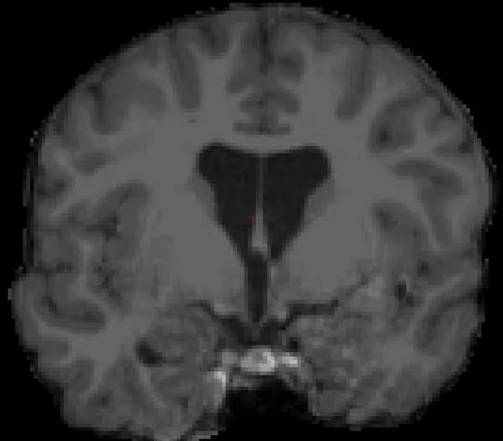
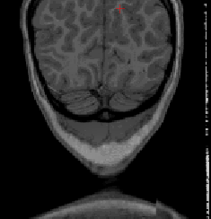
T1w QC
Gibbs phenomenon in the sagital plane
Ghosting effect in the axial plane
Notes:
154_pre gibs

Slide 17
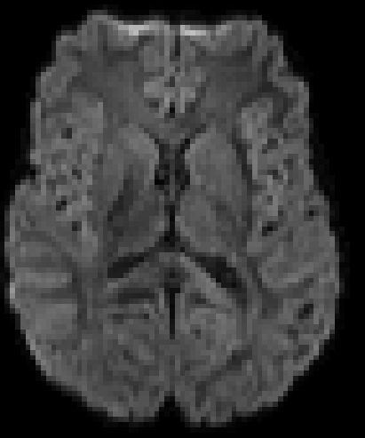
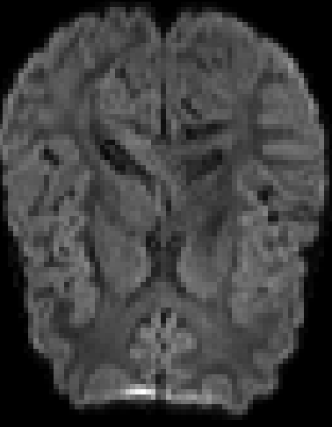
DWI QC
Pulsation effect on the Corpus Callosum
Notes:
Anteriors on top
arrow

Slide 18
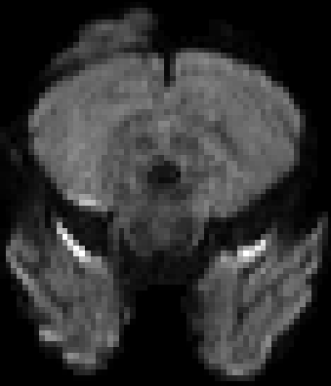
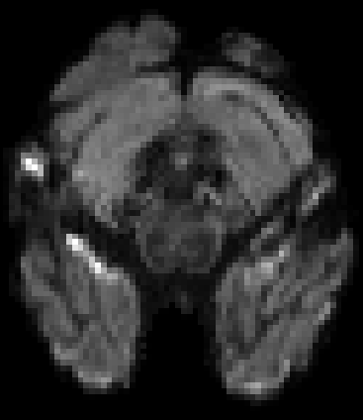
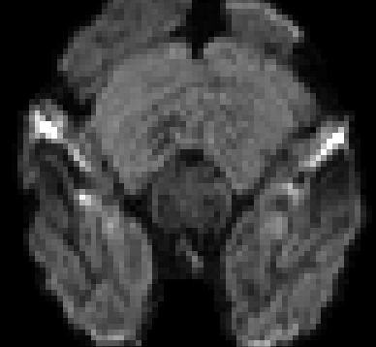
DWI QC
Pulsation effect on the Cerebellum

Slide 19
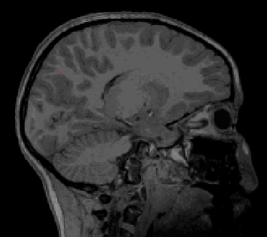
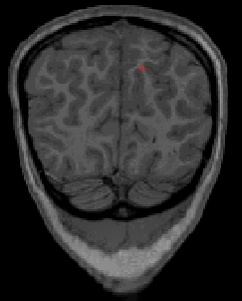
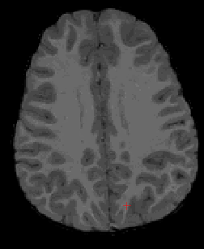
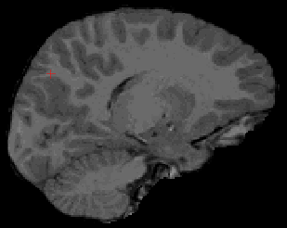
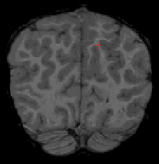
Skull
strip
Removal of the brain surroundings of the T1w with FSL BET (Brain Extraction Tool)
Axial
Sagital
Coronal

Slide 20
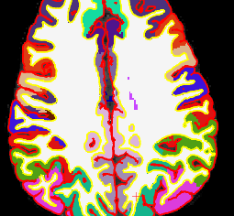
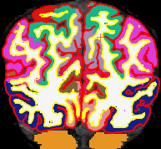
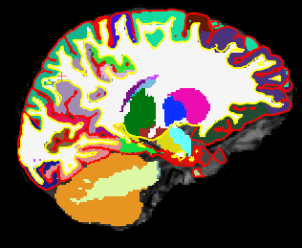
Freesurfer recon-all command performed to classify the brain into hemispheres, structures, white matter, grey matter and its gyri segmentation.
Brain segmentation

Slide 21
Where are we going?

Slide 22
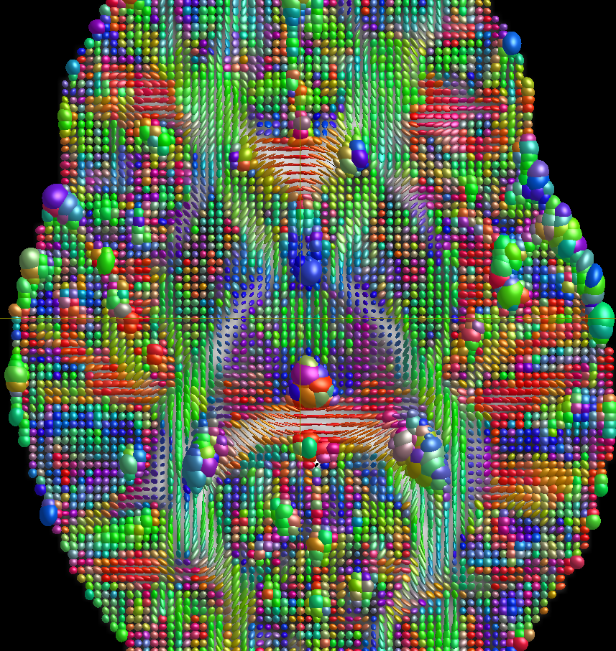
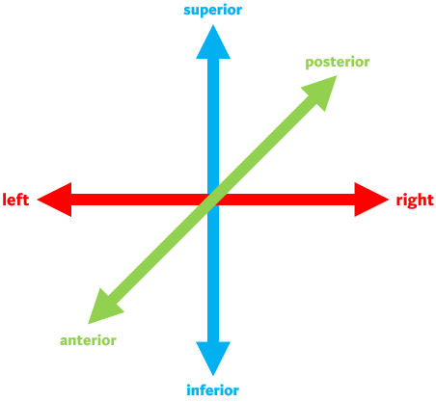
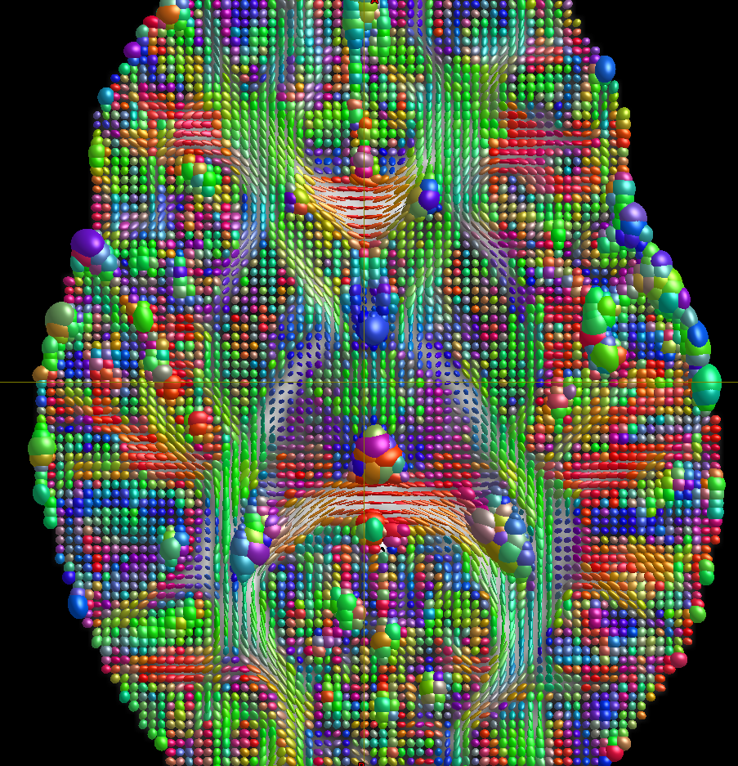
Diffusion Tensor model fitting
Notes:
Contains Fractional Anisotropy in the background and Diffusion Tensor in the foreground with the RGB color map.
Use mouse to explain. Focus on “Want to fit the difusión tensor model”
“underlying wm structure”

Slide 23
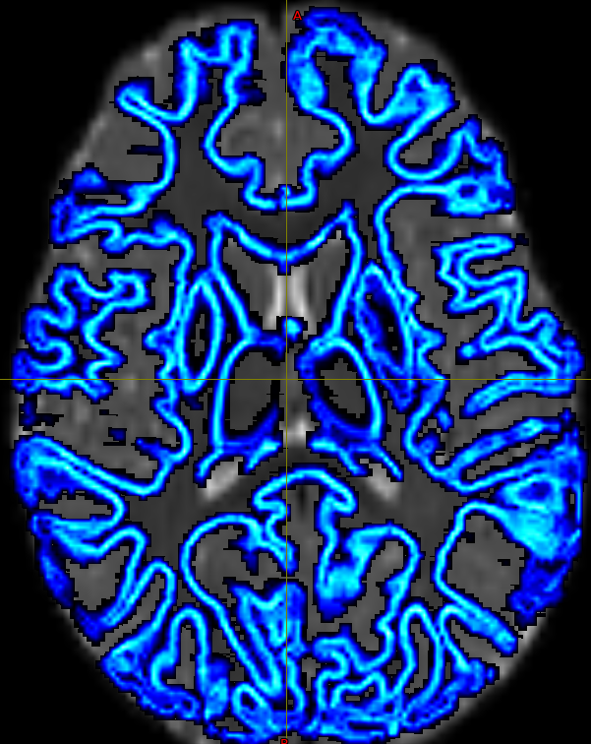
Grey matter – White matter interface for tractography
Extracted five-tissue-type (5TT) using MRTRIX3
Cortical gray matter
Subcortical gray matter
White matter
CSF
Pathological tissue
Presurgery T1w coregistered to DWI space
Notes:
When we have this mask we coregister it to DWI

Slide 24
Where are we going?
Notes:
Move it to where are we going

Slide 25

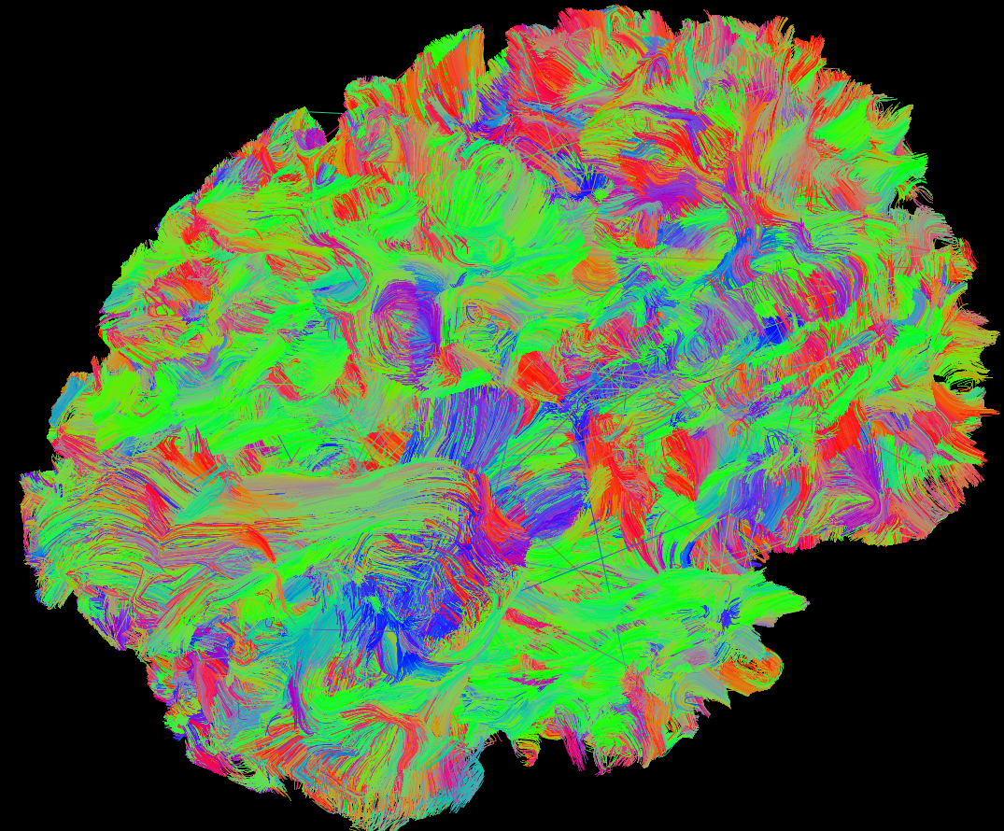
Tractography
Notes:
Predictions no! -> estimation, infered (Google it xD)

Slide 26
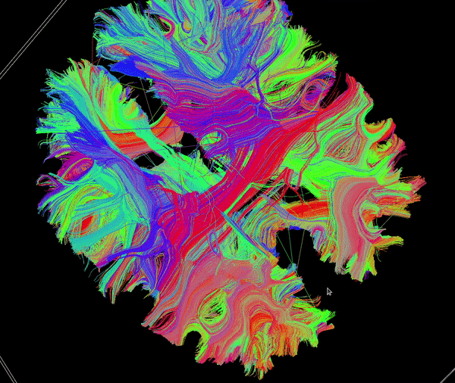
Tractography parameters
MRTRIX3 tckgen:
Tensor_Prob
Anatomically-Constrained Tractography (ACT) thanks to the 5tt
Crop at the gmwmi
Seed in the gmwmi
10M selected streamlines
3D tractography (Z axis) of a preop subject.
Notes:
Look for the how many times (info)
Tractography is the following the direction od the tensor

Slide 27
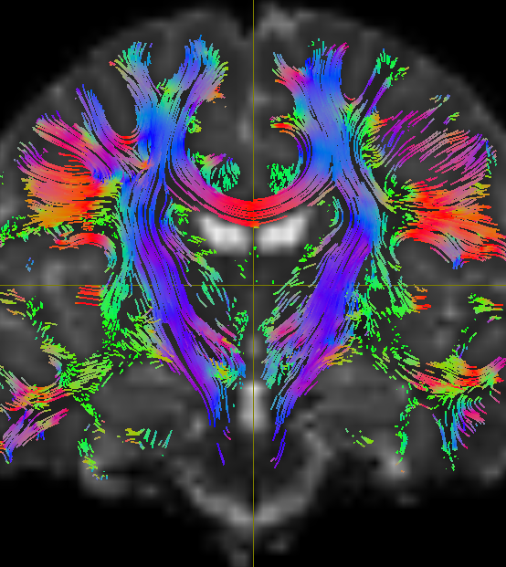
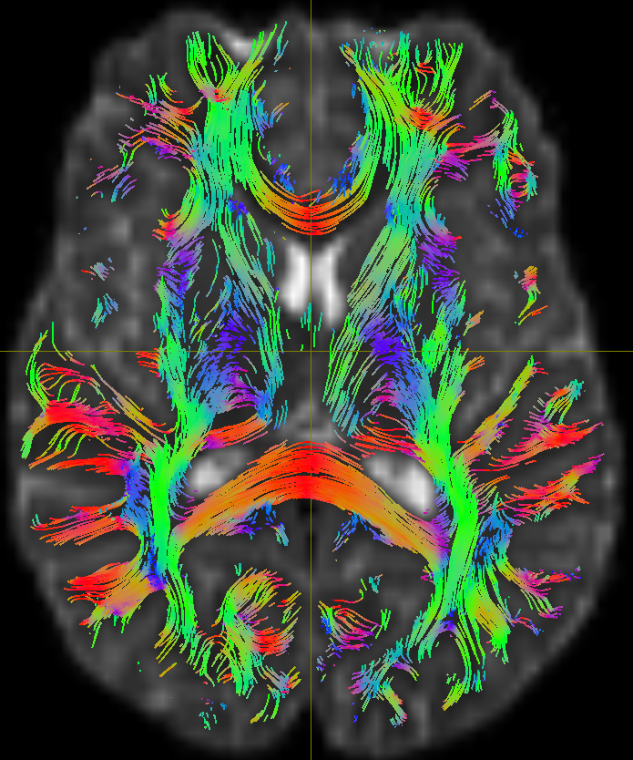
Tractography

Slide 28
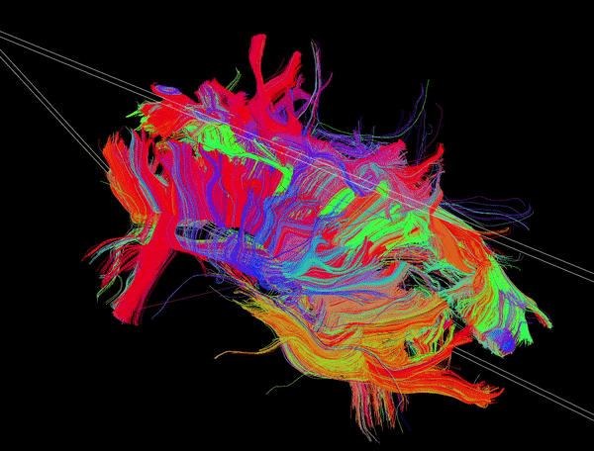
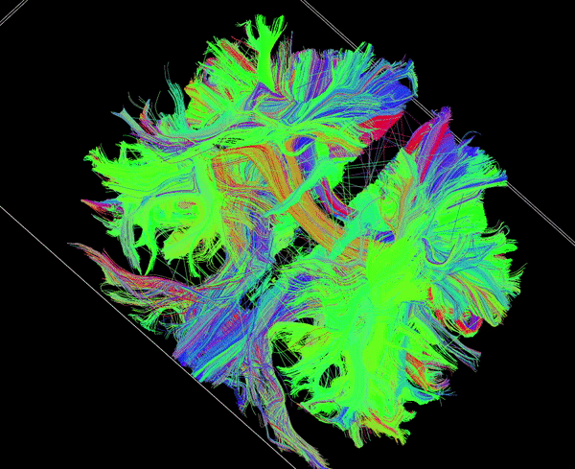
3D tractography (Y axis) of a preop subject.
3D tractography (X axis) of a preop subject.
Notes:
Increase the tracts

Slide 29
Where are we going?
Notes:
Move it to where are we going

Slide 30


Preop
Postop

Slide 31
Preop
Postop
Co-registration of T1w of postop to preop
Notes:
Resection or ablation

Slide 32
Whole brain
Spared brain
Notes:
Connections of T1w masking and removal of the fibers

Slide 33
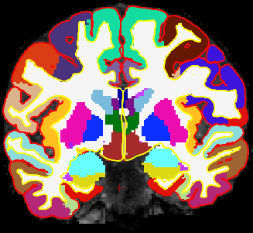
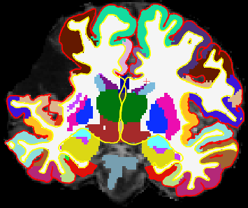
Why spared networks?
Comparison of preop (left) and postop (right) segmentations. The post surgery data contains resections whose segmentation may be questionable.

Slide 34
Where are we going?
Notes:
Move it to where are we going

Slide 35
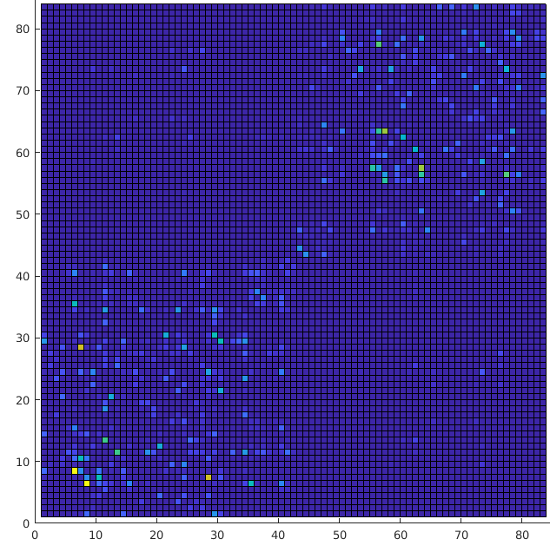
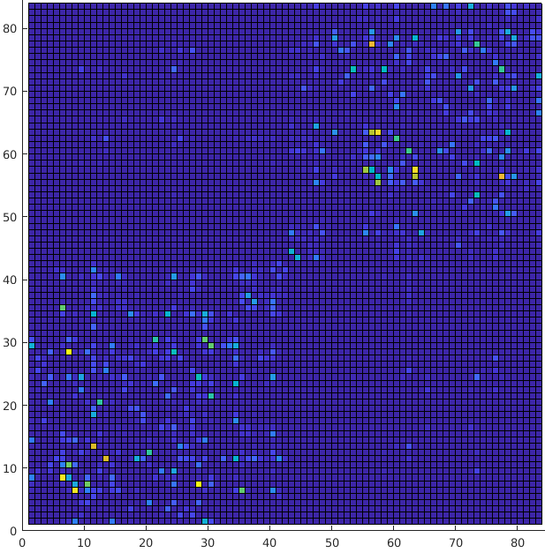
Preop connectome
Postop connectome
Notes:
Mention they are weighted by sum of streamlines, connectomes are normalized 0 to 1, colorbars
Explain what a network (in row and column represents a brain region (x, y)), the value means the number of streamlines
icons?/cartoon/animate the idea

Slide 36

Preop connectome
Postop connectome

Slide 37
Network Measures
Clustering coefficient
Betweenness centrality
Transitivity
Characteristic path length
Degree
Strength
Local efficiency
Global efficiency
BCT (Brain Connectivity Toolbox)
Notes:
We also computed normalised versions of these meausres.
These measures tell us information about the how the brain topography by computing pre and postop (explain the experiment)
Segregation (clustering coefficient, transitivity) & integration (strength, betweenness)

Slide 38


p-value < 0.001
Degrees
Strength
Notes:
Transitivity and global efficiency show decreasing trends after surgery, this suggest there are () we are under power to show significance (sample size is too small)

Slide 39


Transitivity
Global efficiency
Notes:
Transitivity and global efficiency show decreasing trends after surgery, this suggest there are () we are under power to show significance (sample size is too small)

Slide 40


p-value = 0.9428
p-value = 0.4274
net_trans_sr
net_cluster_mean_sr

Slide 41


p-value = 0.5879
p-value = 0.9519
efficiency local
Betweennness

Slide 42


p-value = 0.7354
p-value = 0.5119
Clustering
Clustering

Slide 43




p-value = 0.5096
Betweennness
p-value = 0.9435
net_cluster_mean_sr
Degrees
p-value = 0.6706
*not exact (cant compute with ties)
p-value = 0.5757

Slide 44




efficiency local
efficiency global
p-value = 0.3602
p-value = 0.4859
net_trans_sr
strength
p-value = 0.4331
p-value = 0.552

Slide 45
Analysis pipeline
Inspired by (Sinha et. al, 2020)
Notes:
Add contextual difusión análisis protocol

Slide 46
Future work
A bigger sample may reveal significant trends
Process the DWI of postop instead of spared networks
More gradients and b values allow better methodologies
More subjects
Use of Post DWI
Better DWI data

Slide 47
Acknowledgments
Eleonora Tamilia
Nicolo De Luca
Jee Won
Borjan Gagoski
Winona Bruce Baiden
Kiho Im

Slide 48
Thanks!

Slide 49
References
Larivière, S., Bernasconi, A., Bernasconi, N., & Bernhardt, B. C. (2020). Connectome biomarkers of drug‐resistant epilepsy. In Epilepsia (Vol. 62, Issue 1, pp. 6–24). Wiley. https://doi.org/10.1111/epi.16753
Löscher, W. & Sills, G. J. (2007). Drug resistance in epilepsy: Why is a simple explanation not enough?. Epilepsia, 48 (12), s. 2370–2372. doi:10.1111/j.1528-1167.2007.01260_2.x
Baxendale, S. (2019). Ability to knit may be impaired following right temporal lobe resection for drug-resistant epilepsy. Epilepsy Behavior Case Reports, 11, 22–25. doi:10.1016/j.ebcr.2018.10.001
ChRIS, http://chrisproject.org/info
Eddy, https://fsl.fmrib.ox.ac.uk/fsl/fslwiki/eddy
FSL, https://fsl.fmrib.ox.ac.uk/fsl/fslwiki
MRtrix3, https://www.mrtrix.org
Schirmer, M. D., Chung, A. W., Grant, P. E., Rost, N. S. (2019). Network structural dependency in the human connectome across the life-span. Network Neuroscience, 3(3), 792–806. doi:10.1162/netna00081

Slide 50
FNNDSC. (s. f.). Personnel. FNNDSC Light. https://www.fnndsc.org/personnel
MRtrix 3.0 documentation. (s. f.). labelconvert: Explanation & demonstration — MRtrix 3.0 documentation. MRtrix. Retrieved on November 30, 2021, https://mrtrix.readthedocs.io/en/latest/quantitative_structural_connectivity/labelconvert_tutorial.html#labelconvert-tutorial
Community MRtrix. (2018). Differences between iFOD1/2 and Tensor_Prob. MRtrix3 Community. Retrieved on November 30, 2021, https://community.mrtrix.org/t/differences-between-ifod1-2-and-tensor-prob/1838/8
Community MRtrix. (2021). Reorienting dwi data and bvecs. MRtrix3 Community. Retrieved November 30, 2021, https://community.mrtrix.org/t/reorienting-dwi-data-and-bvecs/5266/4
Community MRtrix. (2019). Aligning dwi to t1 (using flirt). MRtrix3 Community. Retrieved November 30, 2021, https://community.mrtrix.org/t/aligning-dwi-to-t1-using-flirt/2388
Tahedl, M. ( 2020, May 25). B.A.T.M.A.N.: Basic and Advanced Tractography with MRtrix for All Neurophiles. https://doi.org/10.17605/OSF.IO/FKYHT
Sinha, N., Wang, Y., Moreira da Silva, N., Miserocchi, A., McEvoy, A. W., de Tisi, J., Vos, S. B., Winston, G. P., Duncan, J. S., & Taylor, P. N. (2020). Structural brain network abnormalities and the probability of seizure recurrence after epilepsy surgery. In Neurology (p. 10.1212/WNL.0000000000011315). Ovid Technologies (Wolters Kluwer Health). https://doi.org/10.1212/wnl.0000000000011315
Questions and Answers ​in MRI. (n. d.). Isotropic Diffusion. https://mriquestions.com/iso-anisotropic-diffusion.html
O'Donnell, L. J., & Westin, C. F. (2011). An introduction to diffusion tensor image analysis. Neurosurgery clinics of North America, 22(2), 185–viii. https://doi.org/10.1016/j.nec.2010.12.004

Slide 51
superior
posterior
left
right
anterior
inferior
Notes:
with blue indicating superior–inferior, red indicating transverse, and green indicating anterior–posterior.

